Slide 1
RM – Final Project Presentation
Motion Prediction Techniques in Autonomous Vehicles: A Review
Submitted by:
Zubair Idrees : 197301
Adeel Ahmad: 197302
Submitted to Respected Dr. Ahsan Rehman

Slide 2
Agenda
Abstract
Introduction
Problem Statement
Literature Review
Comparison of Existing Models
Conclusion
Future Work
References

Slide 3
Abstract
Autonomous vehicles (AVs) are expected to dramatically redefine the future of transportation. However, there are still significant engineering challenges to be solved before one can fully realize the benefits of self-driving cars. Predicting the Motion of other traffic objects is the most challenging task in autonomous vehicles and self-drive cars, one such challenge is building models that reliably predict the movement of traffic agents around the Autonomous Vehicles, such as cars, cyclists, and pedestrians etc. In this paper, techniques and algorithms used for the motion prediction of other vehicles around autonomous/self-driving vehicles are discussed, later on their review and comparison will be presented along with current challenges and gaps. At the end, the conclusion of this review and direction for future research is presented.

Slide 4
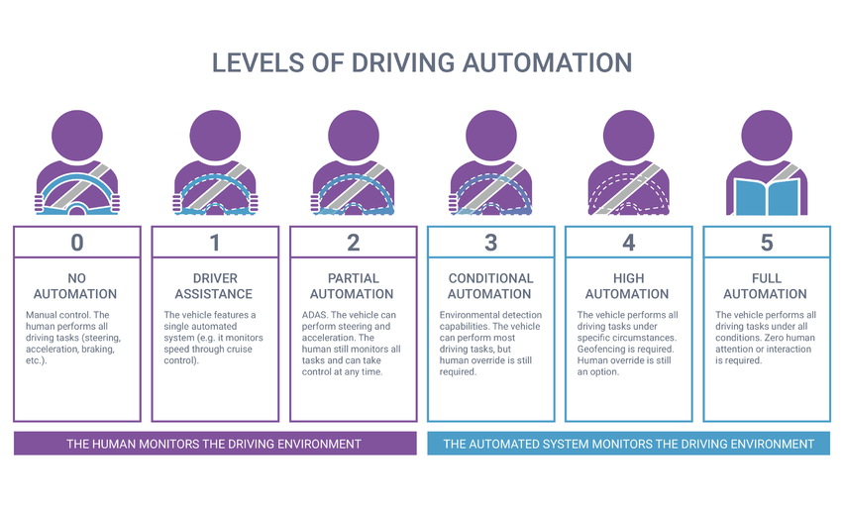
Introduction
Autonomous Vehicles (AV) are today’s reality but still driven under human supervision. The Society of Autonomous Engineers (SAE) defines following 6 levels of Driving Automation[2]:

Slide 5
Introduction
High level components of an Autonomous Vehicle
Sensor architecture in a modern AV system includes multiple sets of cameras, radars, LIDARs and GPS-GNSS system for absolute localization and inertial measurement Units (IMUs) that provide 3D pose of the vehicle in driving environment.
Perception module creates intermediate level representation of the environment state (i.e. bird-eye view map of all obstacles and agents), which is later utilized by decision making system that ultimately produces the driving policy.
A controller defines the speed, steering angle and braking actions necessary over every point in the path obtained from a pre-determined map such as Google maps.

Slide 6
Introduction
Standard components in a modern autonomous driving systems pipeline listing the various tasks. The key problems addressed by these modules are Scene Understanding, Decision and Planning

Slide 7
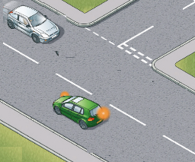
Problem Statement
Prediction in autonomous vehicle is all about how our autonomous vehicle is going to predict the trajectory or path of the other vehicle and take an action to avoid collision.
Think of a situation , you were driving a car on a two lane road, moving forward you want to take a right turn but there is a car in the 2nd lane coming in opposite direction , Now what will you do ?

Slide 8
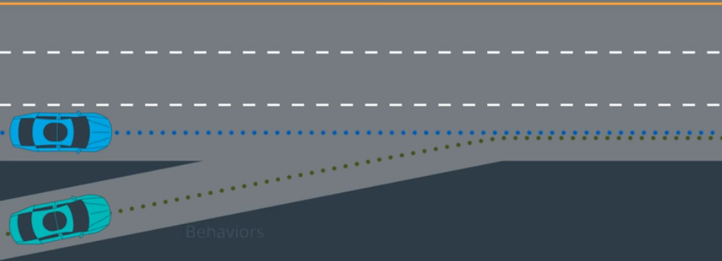
Problem Statement
Suppose that our Autonomous vehicle (Green car) has to come on highway. for that it has to predict the behavior of the blue car .

Slide 9
Literature Review
Lefevre et al. [1] classifies vehicle’s behavior prediction models into physics-based, maneuver-based, and interaction aware models.

Slide 10
Literature Review
Mozaffari et al. [2] suggested state-of-the-art methods and categorized them as (a) input representation; (b) output type; and (c) prediction method. Further deep learning methods for AV’s behavior prediction methods are categories into three classes (i) recurrent neural network, (ii) convolutional neural network, and (iii) other methods (e.g., graph neural networks or combined methods). Long short-term memory (LSTM) model [3] and Gated Recurrent Unit (GRU) [4] are behavior prediction’s main architecture.
Terminologies
Target Vehicles (TVs) are the vehicles whose behavior we are interested in predicting.
Ego Vehicle (EV) is the autonomous vehicle which observes the surrounding environment to predict the behavior of TVs.
Surrounding Vehicles (SVs) are the vehicles whose behavior is explored by the prediction model as it can potentially impact TV’s future behavior. Different studies may adopt different criteria for selecting SVs based on their modelling assumptions.
Non Effective Vehicles (NVs) are the remaining vehicles in driving environment that are assumed to have no impact on the TV’s behavior.

Slide 11
Literature Review
Altch'e et al. [5] trained and tested the Long short-term memory (LSTM) model to anticipate the future trajectories (longitudinal and lateral) for vehicles driving on the highways by utilizing the Next Generation Simulation (NGSIM) dataset.
Xin et al. [6] predicted the interaction of EV with SVs by predicting the long-horizon trajectory for surrounding vehicles (SVs) using dual long short-term memory (LSTM).
Deo and Trivedi [7] provided an interaction-aware prediction model by presenting multi-layer long short-term (LSTM) model. A multi-modal distribution is provided by the model using I-80 and NGSIM US-101 dataset.
Zhao et al. [8] used combination of CNN and LSTM networks by concatenating scene status with agent’s movement vector encoded by CNN and LSTM and fed to network like U-net. Further it’s I/O is fed to LSTM encoder for predicting agent’s future trajectories.
Lee et al. [9] proposed six CNNs for the prediction of lane change intention and control. Simplified BEV was used to reduce the computational cost. But serial data cannot be modeled by these types of CNNs.
Hu et al. [10] used fully connected neural network for the prediction of various scenarios possible by introducing the Semantic-based Intention and Motion Prediction (SIMP) model.
Casas et al. [11] suggested IntentNet as a trainable end to end model by combining semantic high-resolution maps and LiDAR’s 3D point clouds.

Slide 12
Literature Review
Kiran et al. [12] reviewed the different reinforcement learning approaches for autonomous vehicle. In Reinforcement learning methods, an agent learns by experiencing different scenarios and interacting with real environment. Agents performance is improved by maximizing the received accumulative reward during its lifetime. It improves knowledge gradually for long term by exporting previous knowledge and exploring new knowledge. The main challenge faced in reinforcement learning is to balance tradeoff among exploitation and exploration. By using this approach, AVs predict future trajectories by experiencing various scenarios and its reaction w.r.t its environment is improved a lot.
Leurent [13] presented a comprehensive review on various state and action representations that being used in autonomous cars. In AVs, most common state space features used are heading, position, ego-vehicle’s velocity and obstacles in the sensor view of ego-vehicle.
Keselman et al. [14] suggested a model-based reinforcement learning method that for dynamic planning of the trajectories and for providing vehicle’s smooth controlling behavior.
Yung and Ngai [15] provided a solution for vehicles collision and overtaking problem by using a multiple-goal reinforcement learning (MGRL). Q-learning (QL) or double-action QL was used for determining the action-based decisions and to figure out whether surrounding vehicles and AV could reach to same point.

Slide 13
Literature Review
Isele et al. [16] proposed an effective technique to solve the problems related to intersections for AVs specially in jammed intersections and highway merging related problems.
Wang et al. [17] suggested a Deep Reinforcement Learning to provide the solutions for problems related to lane changing in AVs by using Q-learning.
Sallab et al. [18] proposed a Deep Reinforcement Learning (DRL) framework by the combining RNN/LSTM, Q-network and CNN/DNN using spatial and temporal aggregation.

Slide 14
Comparison of Existing Models
Class | Advantages | Disadvantages
Physics based | Easy to compute as they work on the low-level properties of motion (dynamic and kinematic properties), | These models are limited to short-term (less than a second) motion prediction. These are unable to anticipate any change in the motion of the car caused by the execution of a particular manoeuvre (e.g., slowing down, making a turn)
Manoeuvre Intention | It has low computational cost. | Only provides a high-level understanding of the vehicle behaviour. Usually covers manoeuvres that are specifically defined for a single driving scenario.
Interaction aware
Track History of the TV | Complies with limited observability of the EV. | Does not consider the impact of environment and interaction among vehicles on the TV’s behaviour.
Track History of the TV and SVs | Considers the impact of interaction among vehicles on the TV’s behaviour. | Does not consider the impact of environment on the TV’s behaviour. The States of SVs are not always observable to the EV.
Simplified Bird’s Eye View | Considers the impact of environment and interaction among vehicles on the TV’s behaviour. Facilitates fusing the data gathered from different sensors on the EV. Flexible in terms of complexity of representation. It can comply with limited observability of the EV. | Potentially useful information in scene texture is lost
Raw Sensor Data | Complies with limited observability of the EV. No information loss. | High computational cost

Slide 15
Comparison of Existing Models
Class | Advantages | Disadvantages
Neural Network
Recurrent Neural Networks | Good at processing temporal dependencies. | Requires additional mechanism to model interaction and contextual features.
Convolutional Neural Networks | Good at processing spatial dependencies | 2D CNNs lack a mechanism to model data series.
Combination of RNNs and CNNs | Can take advantage of capabilities of both RNNs and CNNs
Graph Neural Networks | Comply with graph structure of traffic. | Static scene context is usually neglected.

Slide 16
Conclusion
We discussed different techniques for motion/trajectory prediction like physics-based models, maneuver-based models, interaction aware models and different deep learning-based models (Single RNN, Multiple RNNs, CNN, Combination of RNNs and CNNs, Graph Neural Networks). Deep learning-based behavior/maneuver prediction methods give better performances as compared to other techniques, more specifically they give better results in complex driving situations. In particular most of the available solutions consider interaction between vehicles, but other factors like traffic laws and environmental conditions are not inputted to prediction model. Additionally, real world limitations like sensor damages and limitations related to computational resources are not fully considered.

Slide 17
Future Work
Several algorithms with different approaches were introduced in area of self-driving/autonomous cars. Different models from basic physics-based to advanced level i.e., deep reinforcement learning based models are presented.
Currently benchmarks are not available for the evaluation of the performance of deep learning and reinforcement learning approaches. There is a need for defining benchmarks for behavior/mauver prediction to evaluate different algorithms’ performance.
Sensor impairment can cause problems in real world AV operations, there should be some mechanism which takes care of such impairments. It can be through some reports sent to owner/authorities of the AVs about the sensor from which AVs are not getting any data for some time.

Slide 18
References
S. Lef`evre, D. Vasquez, and C. Laugier, “A survey on motion prediction and risk assessment for intelligent vehicles,” ROBOMECH Journal, vol. 1, no. 1, p. 1, Jul 2014. [Online]. Available: https://doi:org/10:1186/s40648-014-0001-z
S. Mozaffari, O. Y. Al-Jarrah, M. Dianati, P. Jennings, and A. Mouzakitis, “Deep learning-based vehicle behavior prediction for autonomous driving applications: A review,” IEEE Transactions on Intelligent Transportation Systems, 2020.
S. Hochreiter and J. Schmidhuber, “Long short-term memory,” Neural computation, vol. 9, no. 8, pp. 1735–1780, 1997.
K. Cho, B. Van Merri¨enboer, C. Gulcehre, D. Bahdanau, F. Bougares, H. Schwenk, and Y. Bengio, “Learning phrase representations using rnn encoder-decoder for statistical machine translation,” arXiv preprint arXiv:1406.1078, 2014.
F. Altch´e and A. de La Fortelle, “An lstm network for highway trajectory prediction,” in 2017 IEEE 20th International Conference on Intelligent Transportation Systems (ITSC). IEEE, 2017, pp. 353–359.
L. Xin, P. Wang, C.-Y. Chan, J. Chen, S. E. Li, and B. Cheng, “Intention-aware long horizon trajectory prediction of surrounding vehicles using dual lstm networks, ” in 2018 21st International Conference on Intelligent Transportation Systems (ITSC). IEEE, 2018, pp. 1441–1446.
N. Deo and M. M. Trivedi, “Multi-modal trajectory prediction of surrounding vehicles with maneuver based lstms,” CoRR, vol. abs/1805.05499, 2018. [Online]. Available: http://arxiv.org/abs/1805.05499
T. Zhao, Y. Xu, M. Monfort, W. Choi, C. Baker, Y. Zhao, Y. Wang, and Y. N. Wu, “Multi-agent tensor fusion for contextual trajectory prediction,” in Proceedings of the IEEE Conference on Computer Vision and Pattern Recognition, 2019, pp. 12 126–12 134.
D. Lee, Y. P. Kwon, S. McMains, and J. K. Hedrick, “Convolution neural network-based lane change intention prediction of surrounding vehicles for acc,” in 2017 IEEE 20th International Conference on Intelligent Transportation Systems (ITSC). IEEE, 2017, pp. 1–6.

Slide 19
References
Y. Hu, W. Zhan, and M. Tomizuka, “Probabilistic prediction of vehicle semantic intention and motion,” CoRR, vol. abs/1804.03629, 2018. [Online]. Available: http://arxiv.org/abs/1804.03629
S. Casas, W. Luo, and R. Urtasun, “Intentnet: Learning to predict intention from raw sensor data,” in Conference on Robot Learning, 2018, pp. 947–956.
B. R. Kiran, I. Sobh, V. Talpaert, P. Mannion, A. A. A. Sallab, S. Yogamani, and P. P´erez, “Deep reinforcement learning for autonomous driving: A survey,” arXiv preprint arXiv:2002.00444, 2020.
E. Leurent, “A survey of state-action representations for autonomous driving,” 2018.
A. Keselman, S. Ten, A. Ghazali, and M. Jubeh, “Reinforcement learning with a* and a deep heuristic,” CoRR, vol. abs/1811.07745, 2018. [Online]. Available: http://arxiv.org/abs/1811.07745
D. C. K. Ngai and N. H. C. Yung, “A multiple-goal reinforcement learning method for complex vehicle overtaking maneuvers,” IEEE Transactions on Intelligent Transportation Systems, vol. 12, no. 2, pp. 509–522, 2011.
D. Isele, A. Cosgun, K. Subramanian, and K. Fujimura, “Navigating intersections with autonomous vehicles using deep reinforcement learning,” CoRR, vol. abs/1705.01196, 2017. [Online]. Available: http://arxiv.org/abs/1705.01196
P. Wang, C. Chan, and A. de La Fortelle, “A reinforcement learning based approach for automated lane change maneuvers,” CoRR, vol. abs/1804.07871, 2018. [Online]. Available: http://arxiv.org/abs/1804.07871
A. Sallab, M. Abdou, E. Perot, and S. Yogamani, “Deep reinforcement learning framework for autonomous driving,” Electronic Imaging, vol. 2017, no. 19, p. 70?76, Jan 2017. [Online]. Available: http://dx.doi.org/10.2352/ISSN.2470-1173.2017.19.AVM-023

Slide 20
Thank you
Questions?

